Slide 1

Student Council Website
PRESENTED BY-
Aditya Maskare (23102169)
HITESH MORYE (23102202)
GAYATRI MAHAJAN (23102009)
ABHISHEK MISHRA (23102180)
Under the guidance of
Prof. Manjusha Adsare

Slide 2
PROBLEM STATEMENT
The college's student council currently lacks an effective online platform, hindering communication and engagement with the student body. A dedicated web page is needed to address the following issues:
Dispersed information about council activities and events
Limited student participation in council decisions
Insufficient visibility of council members and their roles
Difficulty accessing important documents and resources
Developing a comprehensive web page will centralize information, facilitate student involvement, and enhance transparency, ultimately fostering a more connected and informed campus community.

Slide 3
OBJECTIVES
Enhance Student Life :
Organize engaging social, recreational, and educational events to enrich campus culture.
Advocate for Students :
Serve as the voice of the student body and work with administration to address student concerns.
Foster Community :
Promote inclusivity, diversity, and unity among all students through various initiatives.
Leadership Roles :
Discover the various responsibilities and opportunities available when you join the Student Council at your school.

Slide 4
SCOPE
Student Engagement :
Organize and promote campus events, clubs, and activities to engage the student body.
Student Representation :
Serve as the liaison between students and faculty/administration to address concerns.
Student Wellness :
Collaborate with on-campus resources to support the mental, physical, and emotional well-being of students.

Slide 5
KEY FEATURES
Events Calendar :
Stay up-to-date on all upcoming student council events and activities.
Student Community :
Connect with fellow students, join clubs, and get involved on campus.
Campus Resources :
Access information about various on-campus support services and initiatives.

Slide 6
OBJECTIVE REVIEW
We have created a UI design where it shows the login page.
And further it shows HOME PAGE where we have linked around 4-5 pages to elements in the drop down. We have added the photos of our current council members.
We also have added the navigation bar which shows the subsections.

Slide 7
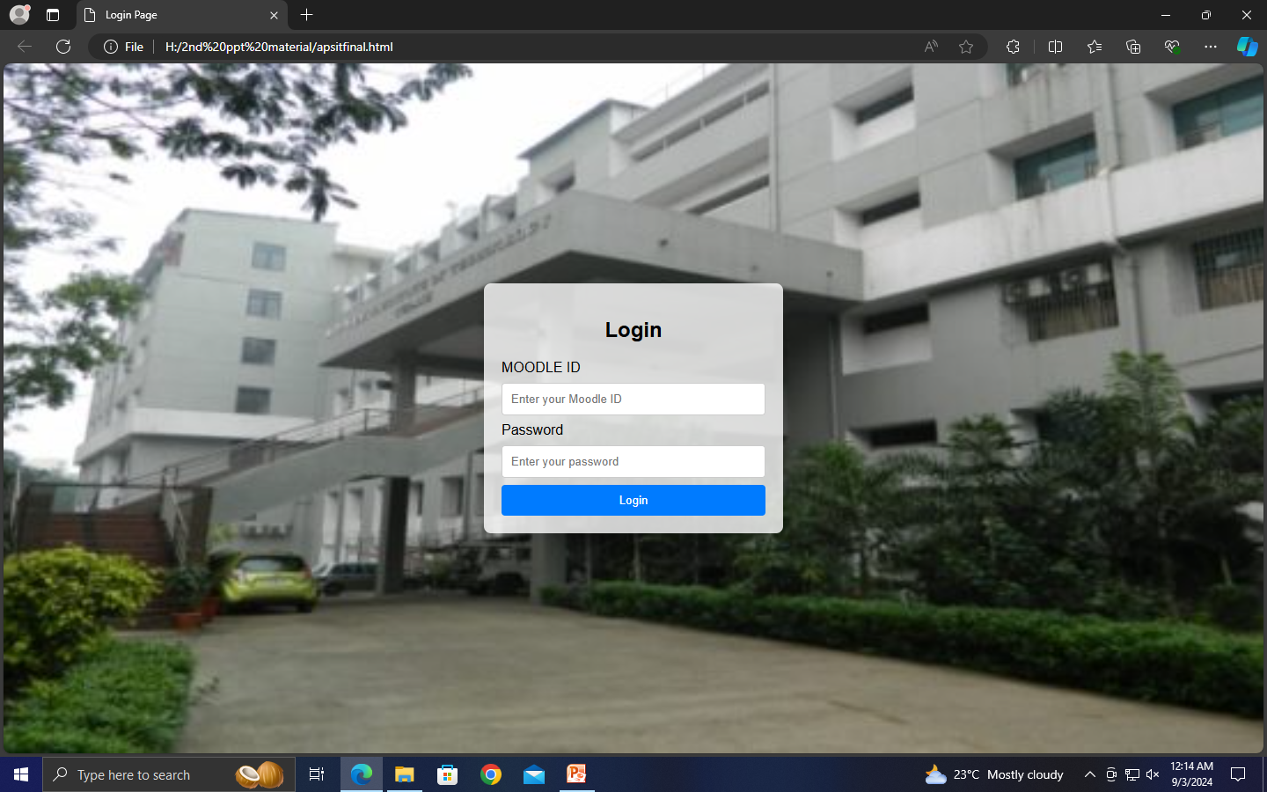
WORK COMPLETION STATUS
Login page is created.

Slide 8
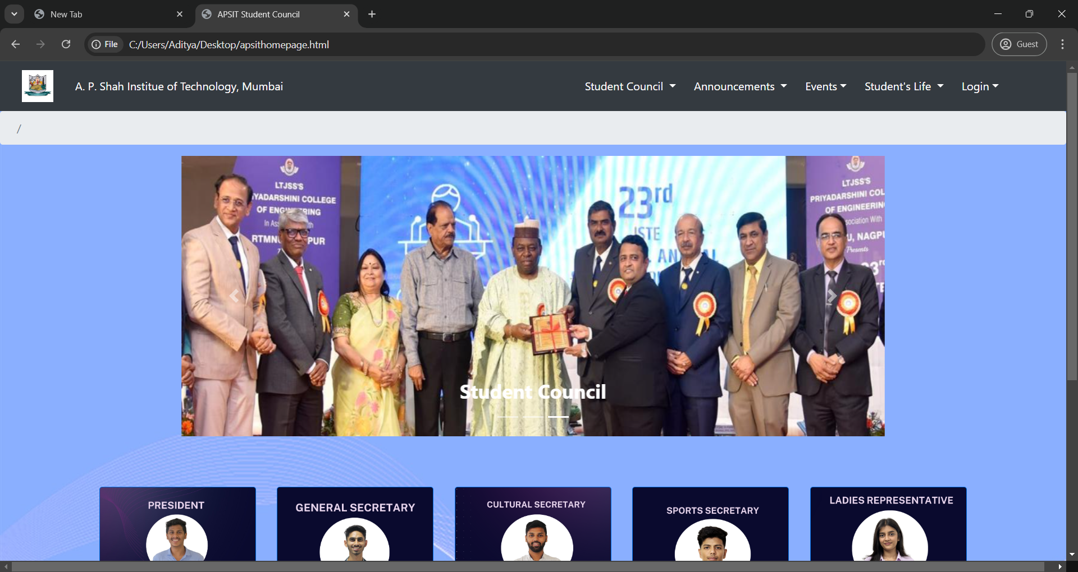
WORK COMPLETION STATUS
Homepage is created.

Slide 9
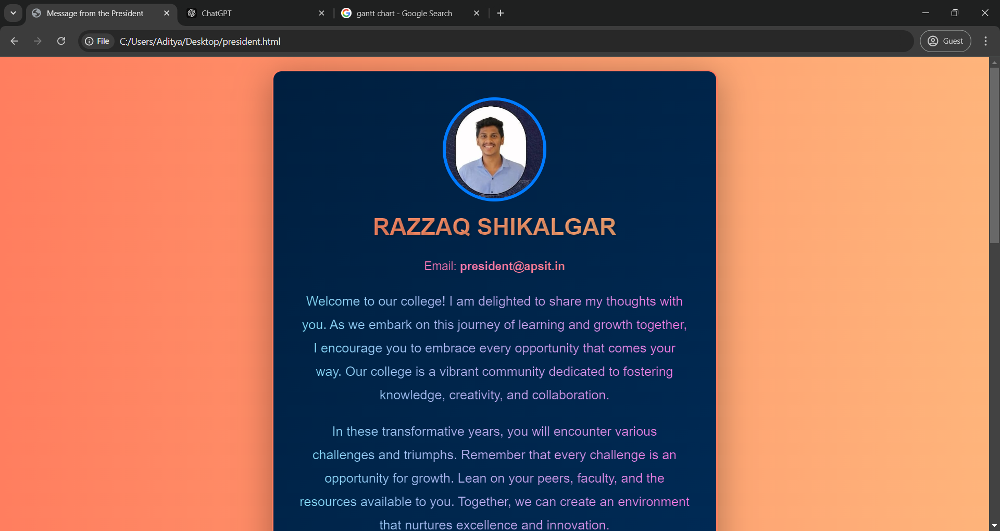
WORK COMPLETION STATUS
Message from President

Slide 10
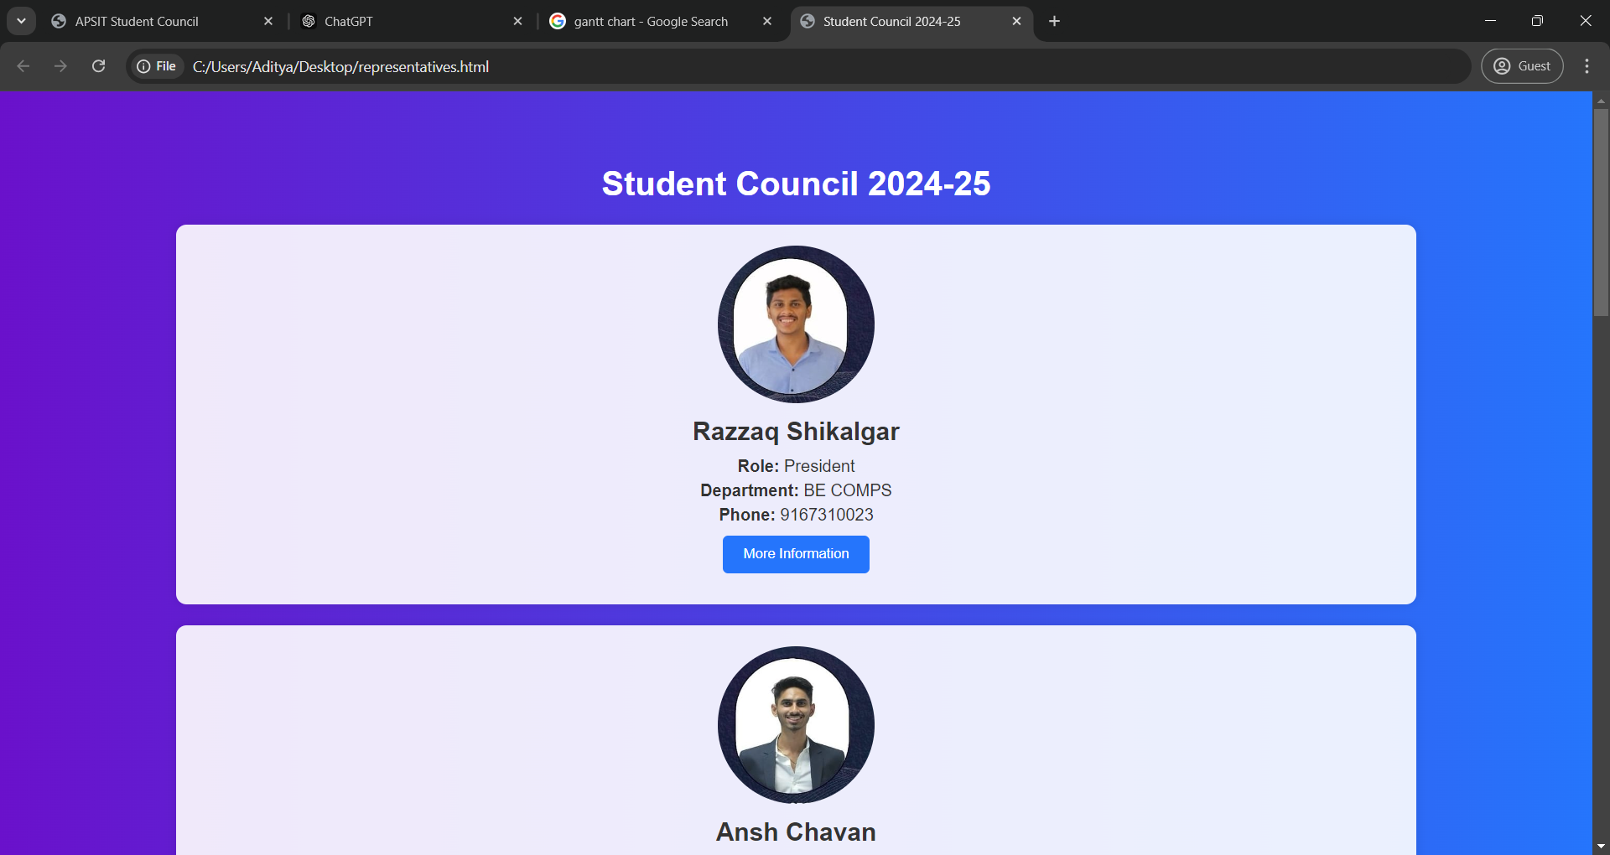
WORK COMPLETION STATUS
Meet the Representatives

Slide 11
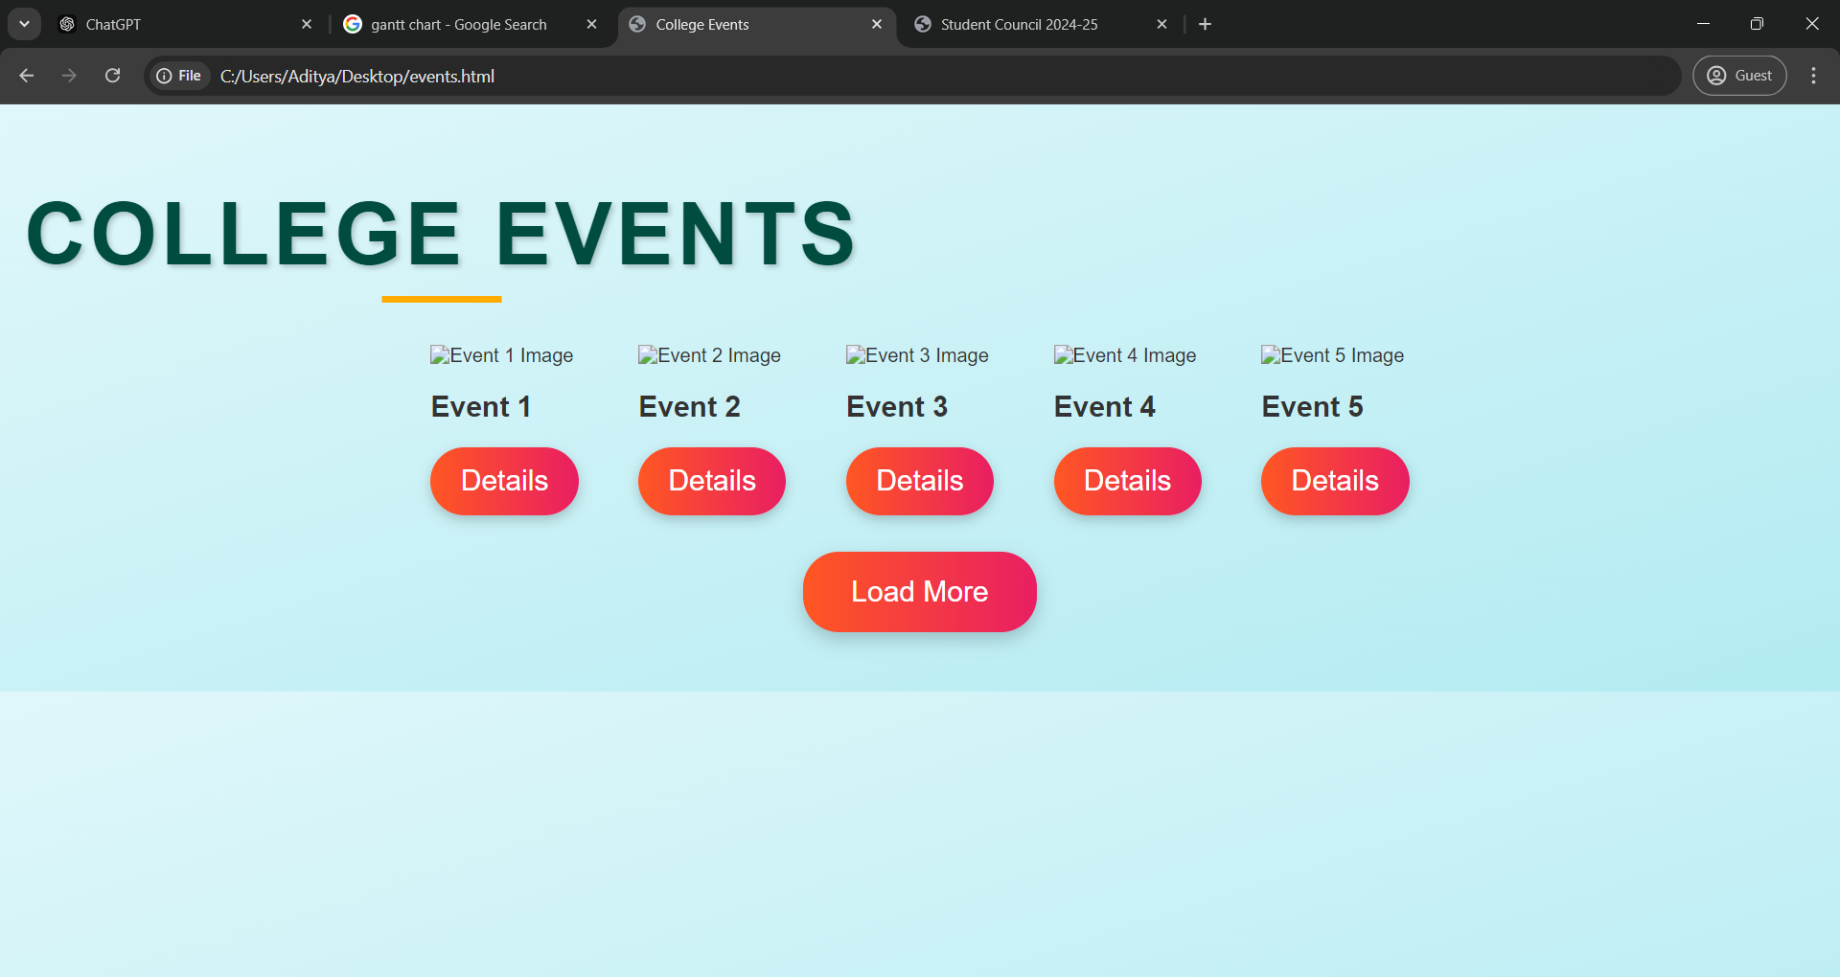
WORK COMPLETION STATUS
College Events

Slide 12
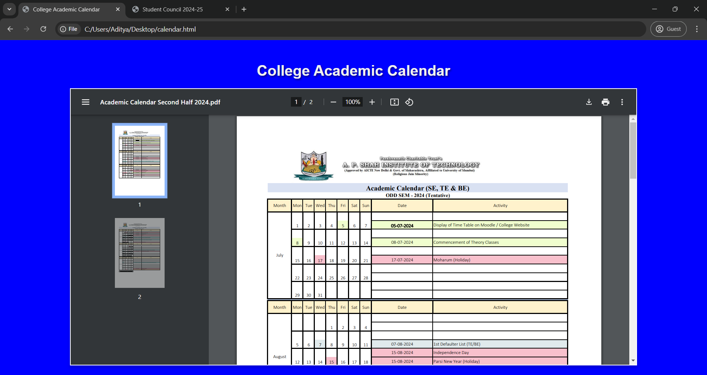
WORK COMPLETION STATUS
Event Calendar

Slide 13
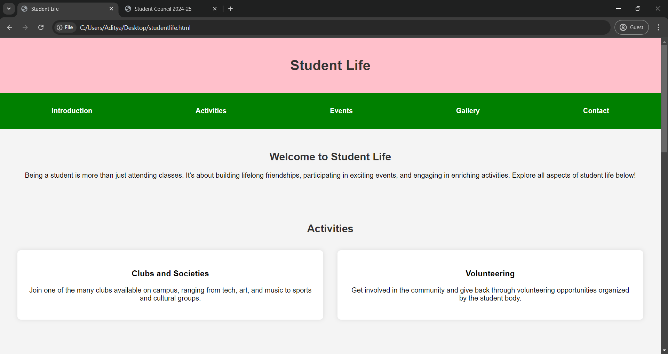
WORK COMPLETION STATUS
Student Life

Slide 14
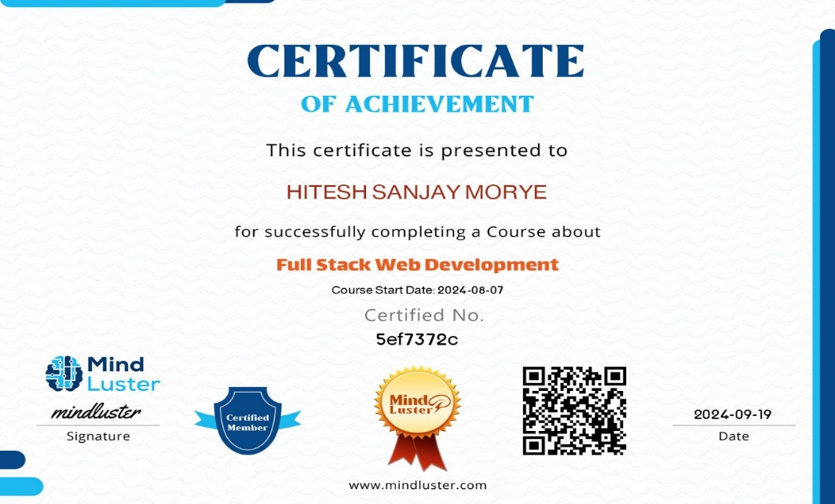
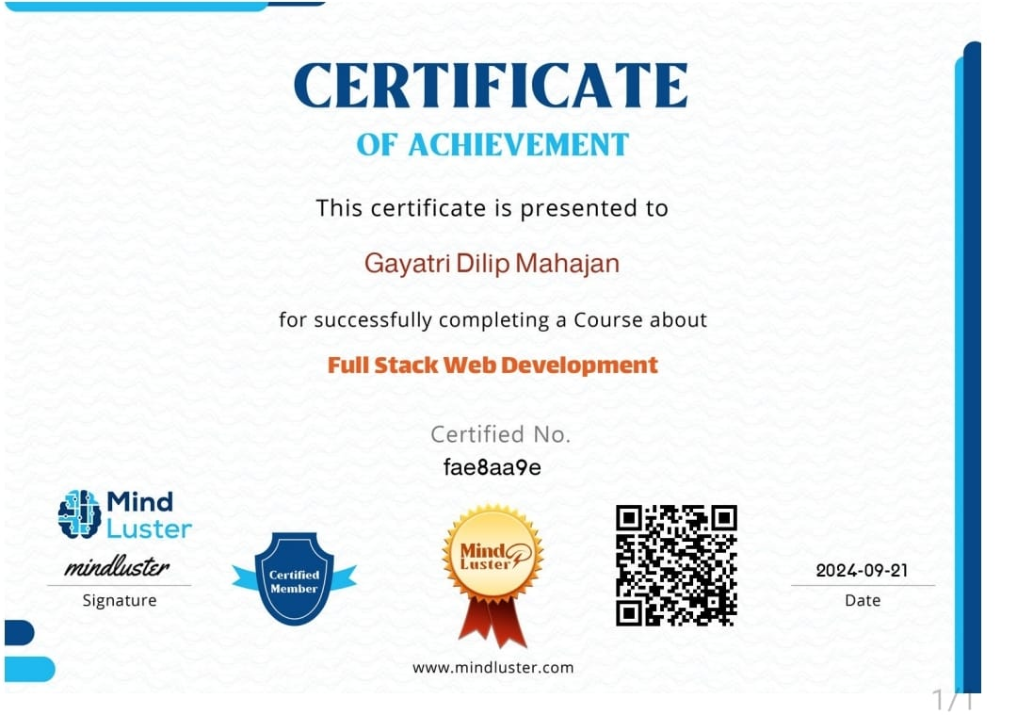
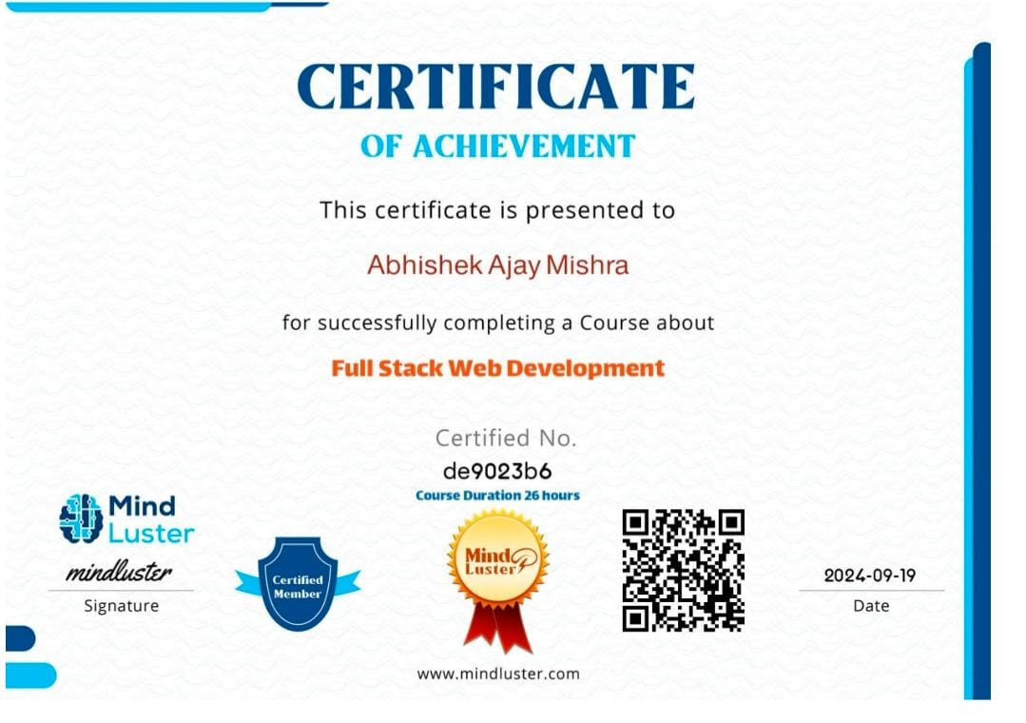
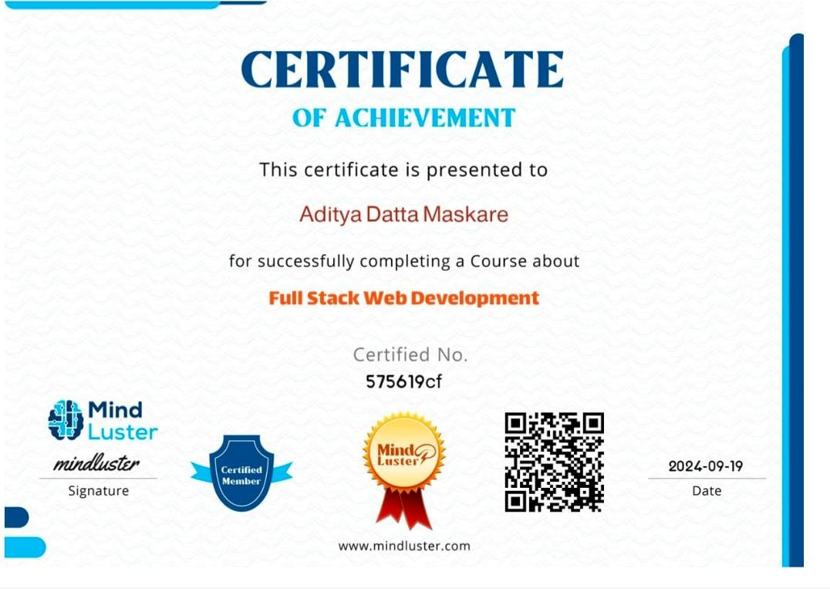
CERTIFICATION STATUS

Slide 15
PENDING WORK
Connecting Databases is remaining.
Implementing NodeJS, MongoDB.
Some pages are remaining to be linked.

Slide 16


